Slide 1

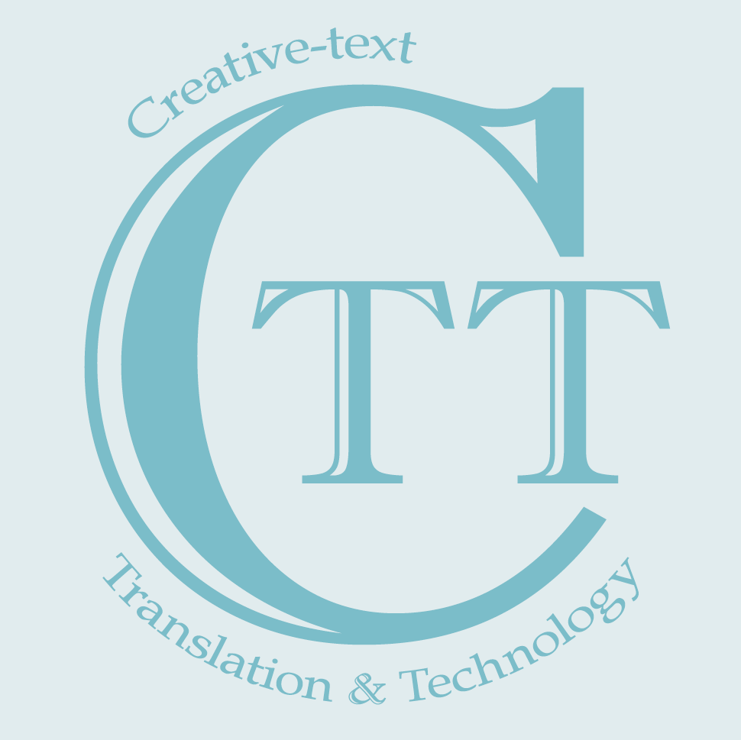


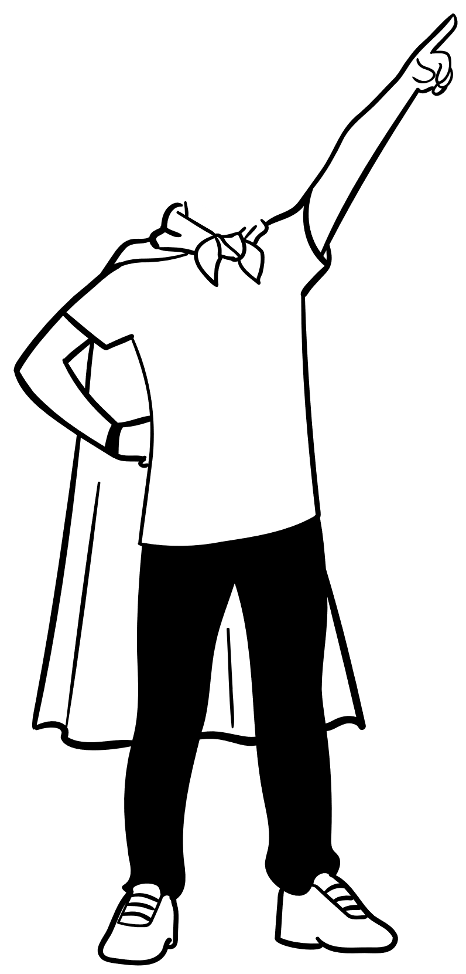





Can Peter Pan Survive MT? A Stylometric Study of LLMs, NMTs, and HTs in Children's Literature Translation
Delu Kong^{1,2}; Lieve Macken²
¹School of Foreign Studies, Tongji University
²LT3, Ghent University

Slide 2
Content
Introduction
Methodology
Results
Discussion
Conclusion
-- Why Peter Pan and Why MT
-- Data, features and algorithms
-- HTs > LLMs > NMTs!
-- What separates them apart
-- TLDR

Slide 3
Introduction

Slide 4
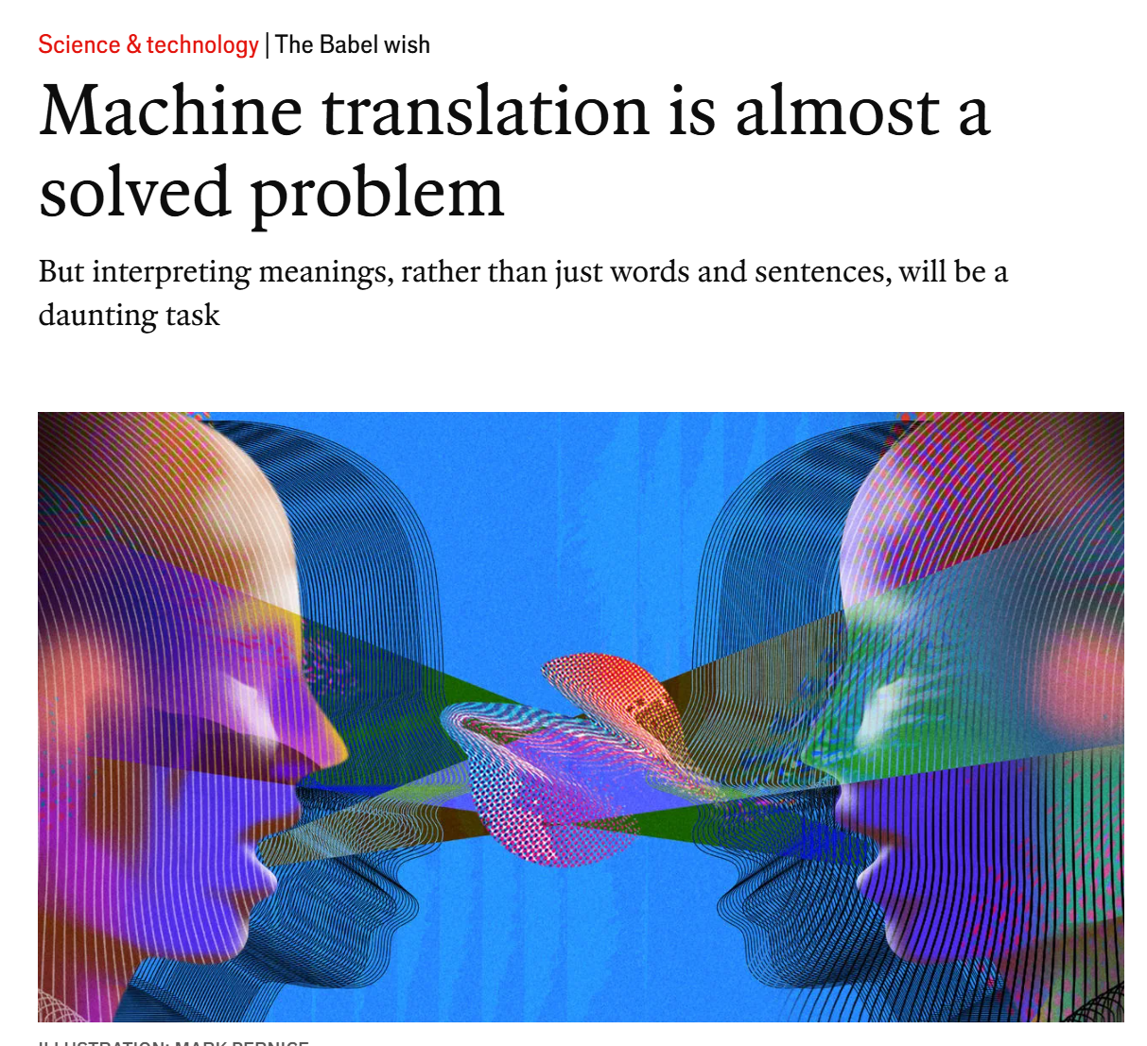
MT – A solved problem?

Slide 5


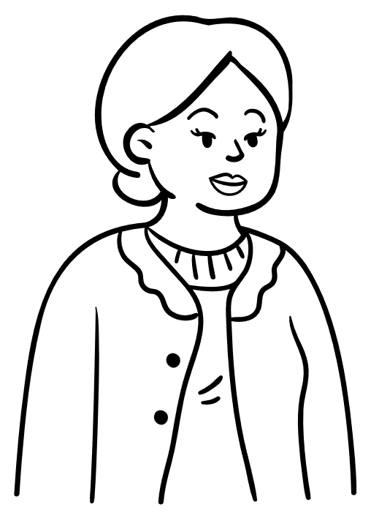
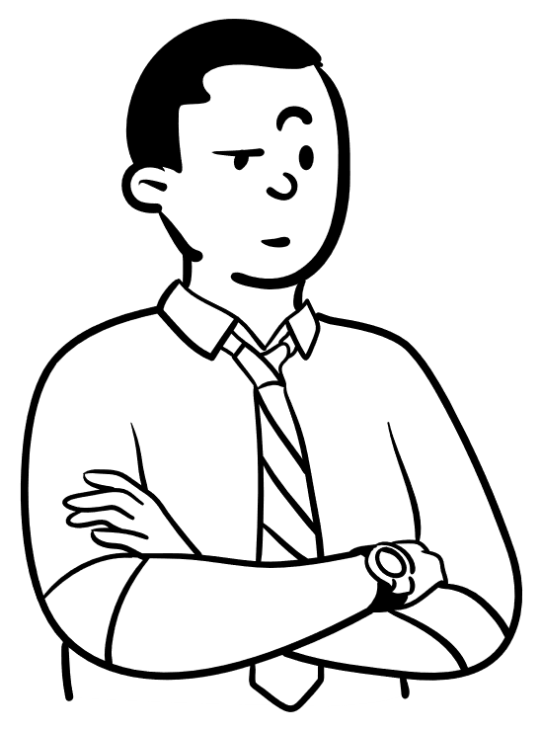
MT – A solved problem? Online responses
“… the public perception … is now that MT does the job fine”
“[MT] good enough for at least 90% of all translated content as far as clients (and non-linguist readers) are concerned.”
MT is cheap, easy-to-use, and it saves time.
“Absolutely, AI is impressive. But where the stakes are high 95% just isn't good enough. Medical, finance, technology...”
“Swedish in Google Translate was bad (translationese flavor throughout, copies sentence structure verbatim, reads like an Amazon MT product description).”
“[MT] starts with wordiness… and it ends … with another wordiness.”

Slide 6
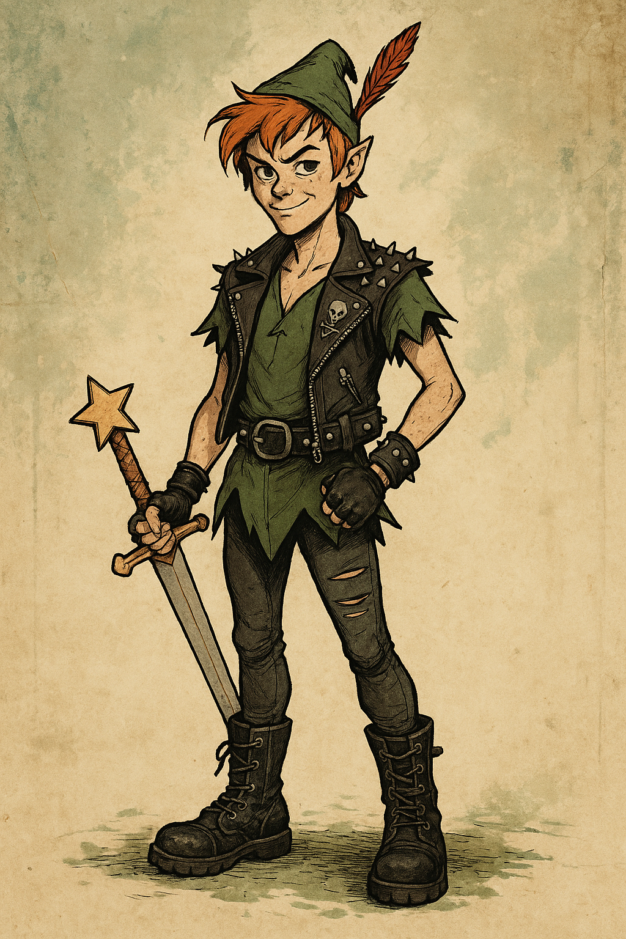
Peter Pan, the boy who wouldn’t grow up
Sir James Matthew Barrie
A Timeless Classic, 1911 till now around the world
A Literary Text – the “Last Bastion” (Toral & Way, 2014) of Machine Translation
Children’s Literature as High-Stakes Text
Abundant Human Translations for Comparative Analysis
Notes:
A Timeless Classic First published in 1911, by Sir James Matthew Barrie. Peter Pan remains one of the most iconic and enduring works in children’s literature.
a cultural icon symbolizing youthful innocence and escapism The story centers on the dream of never growing up, blending adventure with deep emotional and philosophical layers.
Linguistic and Stylistic Richness Filled with metaphor, humor, and imaginative language—ideal for analyzing literary translation and machine translation challenges.

Slide 7
Related research
Focus | Study (Year) | Object | Key Insight
Stylometric Analysis in Children’s literature translation (CLT) | Puurtinen (2003) | Finnish CLT | Translation style shown in non-finite structures, less colloquialism markers
 | Čermáková (2018) | English CLT | Translators mitigate repetition via synonymy
 | Zhang (2019) | CN→EN CLT | Increased pronoun use due to source influence
 | Zhao (2022) | CN→EN CLT | Selective appropriation is the dominant strategy
Applies corpus-based and feature-driven approaches (e.g., repetition, pronouns, narrative structure)
Focuses primarily on human-translated texts, not NMT or LLM outputs
Unique stylistic features in CLT texts

Slide 8
Related research
Study (Year) | Focus | Key Insight
Toral (2014) | Feasibility of MT for literature | Raised early concerns about MT’s limitations in literary translation
Toral & Way (2015) | SMT adaptation | SMT fine-tuned for literature outperformed generic MT; useful in workflows
Toral et al. (2018) | NMT evaluation for novels | NMT showed 11% improvement over SMT, but qualitative concerns remain
Moorkens (2018), Way (2023) | Translator attitudes | Experienced literary translators often reject NMT to preserve freedom
Guerberof Arenas (2024) | Reader reception | MT output rated lowest for clarity and engagement vs. HT and PE
Daems (2022) | Stylistic limitations | MT fails to render humor, nuance, and cultural cues effectively
Farrell & Taivalkoski-Shilov (2018) | Ethical/stylistic critique | MT leads to homogenization, reduces creativity in target texts
Jiang (2022) | Discourse coherence | NMT texts are less cohesive and lexically consistent than HTs
Rybicki (2025) | Stylistic detection | MT texts show measurable style differences; detectable from HTs
MT evolves! NMT shows technical improvement in literary texts
Translators resist MT due to creative constraints
Readers perceive NMT as less engaging and coherent.
Notes:
This is a long list of literary review on studies in Machine Translation in Creative Texts.
But we also generate three tendencies from these studies.
NMT shows technical improvement, but struggles with style
→ E.g., BLEU scores improve (Toral et al., 2018), but stylistic nuance—humor, rhythm, cultural cues—is often lost (Daems, 2022). ✅ Use this to highlight the “form vs. function” dilemma in literary MT.
the very nature of creative texts almost implies an inherent degree of resistance to automation. – paola ruffo
Translators resist MT due to creative constraints → Professional literary translators prefer manual work for freedom and voice (Moorkens, 2018; Way, 2023).
Readers perceive MT as less engaging and coherent → MT versions score lowest in narrative clarity and reader focus (Guerberof, 2024); discourse coherence and lexical consistency also suffer (Jiang, 2022).

Slide 9


Gaps and Questions
Stylometric methods underused in CLT research, also lack specific feature set
Distant language comparison is rare, such as Eng-Chs
MT research rarely targets children’s literature
LLMs remain unexplored in CLT translation
RQ1: How do MTs differ from HTs in both generic and CTT-specific features?
RQ2: How do LLM outputs compare with NMT outputs on these features?
RQ3: What salient features best illustrate the distinctions among HTs, NMTs, and LLMs?
Notes:
🔍 Highlights
Stylometric methods underused in CLT research → Most CLT studies focus on translation strategies or qualitative patterns; stylometric analysis is still limited.
Distant language comparison is rare, such as Eng-Chs
MT research rarely targets children’s literature → Existing MT-for-literature studies focus on adult fiction; CLT’s linguistic and stylistic uniqueness is overlooked.
LLMs remain unexplored in CLT translation → Despite growing interest in LLMs, their performance on CLT is rarely examined or benchmarked.

Slide 10
Methodology

Slide 11
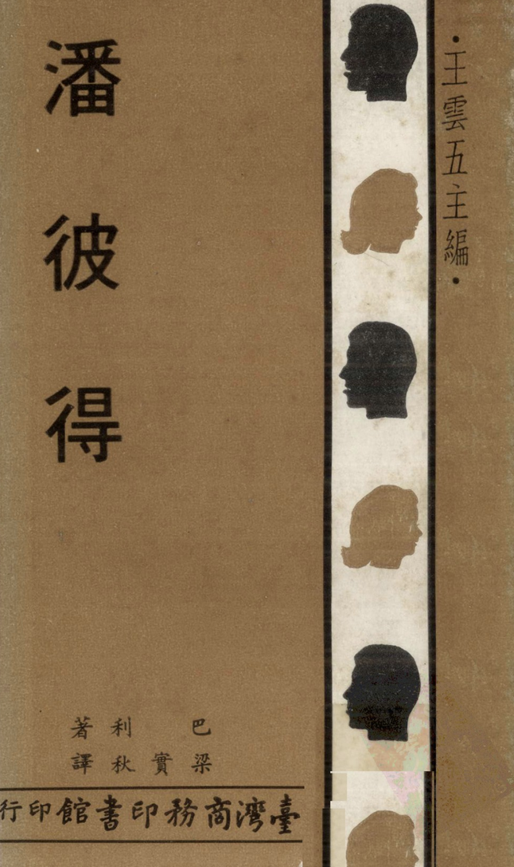





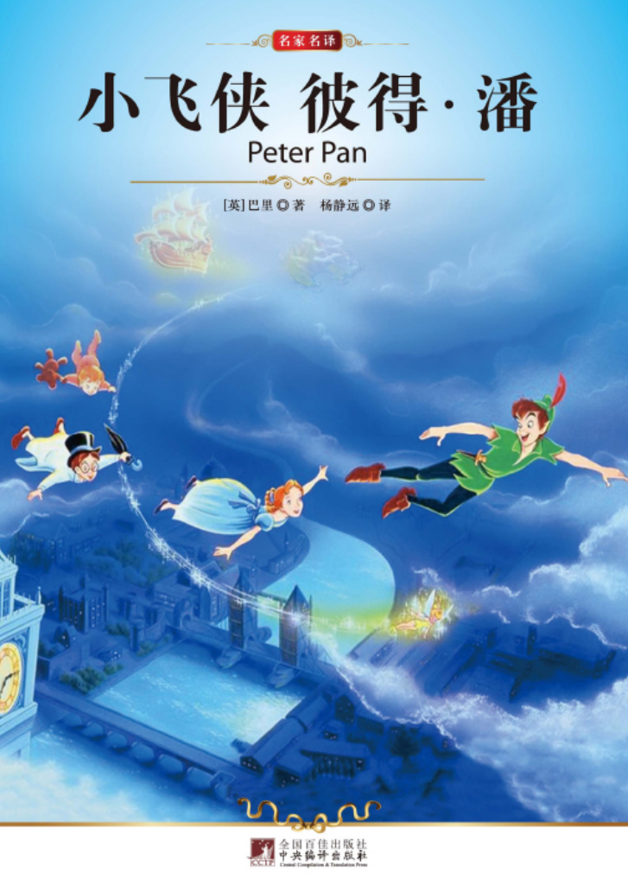
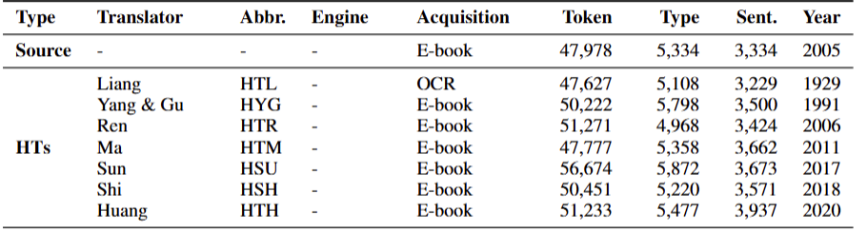
Data - HTs
OCR
Digitalized
De-noised
Pre-processing
PoS-Tagging
Dep-Tagging
All you need to remember: HT samples start with H ~

Slide 12




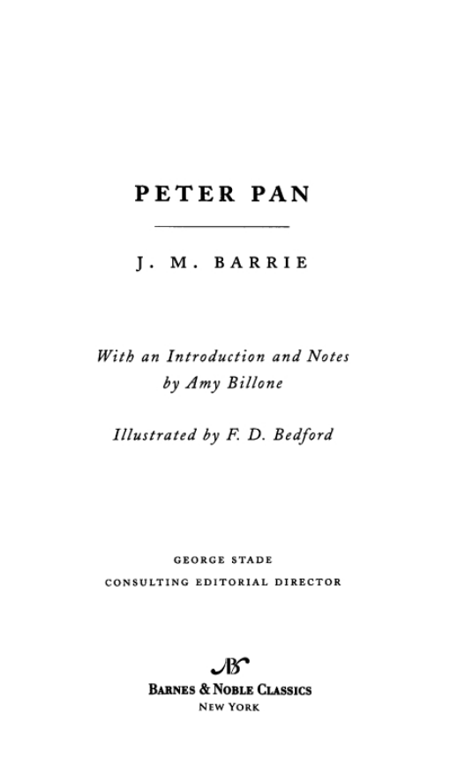




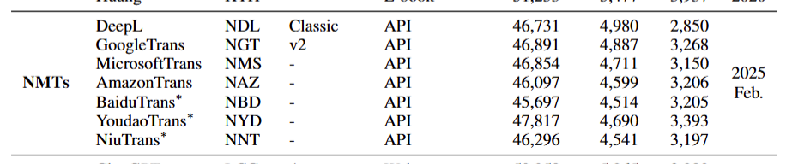
Data - NMTs
Digitalized
De-noised
7 NMTs
API
All you need to remember: NMT samples start with N ~

Slide 13










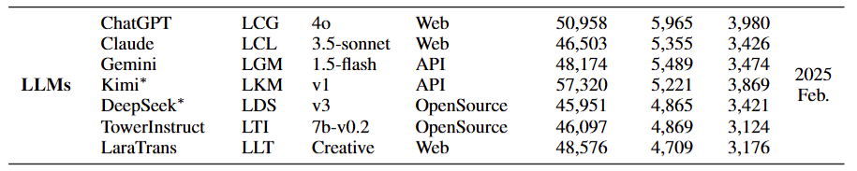
Data - LLMs
Structured prompt:
Roles + Tasks + Steps
7 LLMs
Open + Close
All you need to remember: LLM samples start with L ~
Oh! We use MTs to combine NMTs and LLMs!

Slide 14
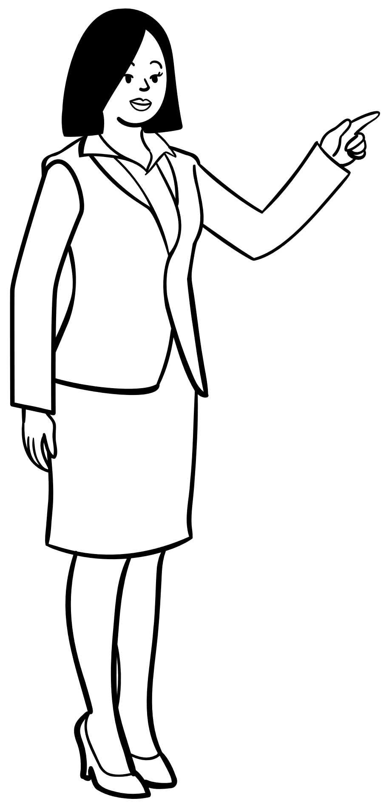

Feature set – Total 447 features
Generic
Lexical (69)
N-gram (309)
TTR，AvgWordLength, MTLD, Noun, Verbs, Pron, Idioms…
Syntactical (26)
Avg.Sent.Length, QuestionSent, MDD, AvgChildrenPerNode
Readability (16)
LexicalRichness, Concreteness score, AvgConcrete
N_word_gram, N_PoS_gram,
N = 1 - 3
CTT-specific
Repetition (7)
Miscellaneous (5)
ratio_AA, ratio_ABAB, ratio_AAA, ratio_AABB
Rhythm (10)
Open Syllable Ratio, Rhyme Density, Rhyme Ratio
Translatability (5)
completeness, foreignness, code_switching, untranslatables
ratio_onomatopoeia, ratio_StrongModifier, ratio_er_suffix

Slide 15







Algorithms
Classification
SVM, decision tree …
TO see if different group of samples could be separated by multiple classifiers.
Clustering
Kmeans, Stylo()
TO assess how closely the translation samples align with one another.
Visualization & Validation
Feature selection
Chi-square (χ²) ranking
TO reduce dimensionality and retain discriminative features
Top-k: Selected the top 30 features

Slide 16
Results

Slide 17
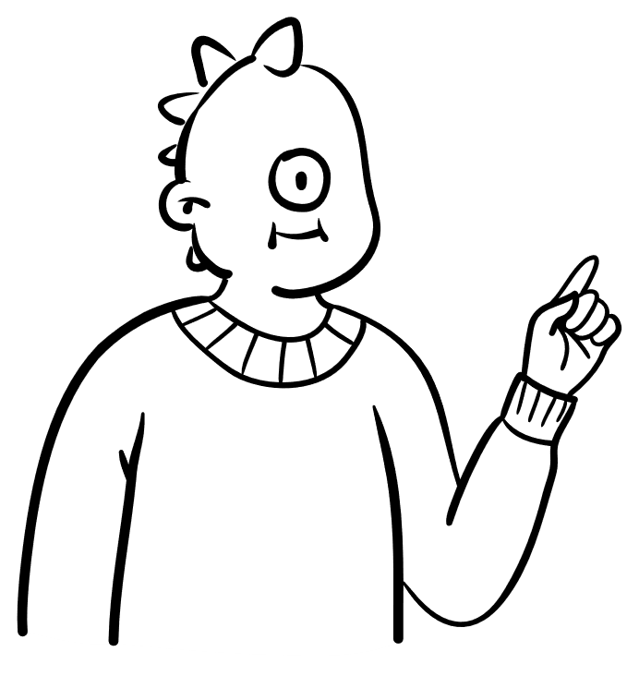



Classification
Level | Sub-level | HTs-MTs | HTs-NMTs | HTs-LLMs | NMTs-LLMs
Generic textual features | Lexical | 0.8673 | 0.9149 | 0.8526 | 0.7439
 | Syntactical | 0.8001 | 0.8443 | 0.7128 | 0.6752
 | Readability | 0.6645 | 0.7056 | 0.5538 | 0.6178
 | N-gram | 0.8674 | 0.8803 | 0.8486 | 0.7724
CTT-specific features | Repetition | 0.6274 | 0.68 | 0.5778 | 0.5436
 | Rhythm | 0.665 | 0.5564 | 0.6444 | 0.5593
 | Translatibility | 0.6883 | 0.793 | 0.6091 | 0.6067
 | Miscellaneous | 0.7378 | 0.7521 | 0.6393 | 0.6172
All | - | 0.9149 | 0.9376 | 0.8896 | 0.7464
For RQ 1, HTs vs. MTs
Very high acc.
H-N > H-L
😀
For RQ 2, NMTs vs. LLMs
Good acc.
Similar and different
🤨
Additional: Intra-group
Ewww! Poor
HT group is better
🥲
 | HTs | NMTs | LLMs
Intra-group | 0.6785 | 0.5965 | 0.5917
Which feature level matters?
✅ Lexical, N-gram ↑ ⚠️ Translatability, Miscellaneous ↑ 🏆 All features > Generic > CTT-specific
Notes:
✅ Lexical and N-gram features perform best among generic features, especially for distinguishing HTs and NMTs. ❌ Readability performs the worst, with notably low accuracy for HTs vs. LLMs. ⚠️ Among CTT-specific features, Translatability and Miscellaneous help differentiate HTs, ❌ but Repetition and Rhythm drop sharply in performance. 🏆 Overall, using all features together gives the best results, followed by generic features, then CTT-specific ones.

Slide 18
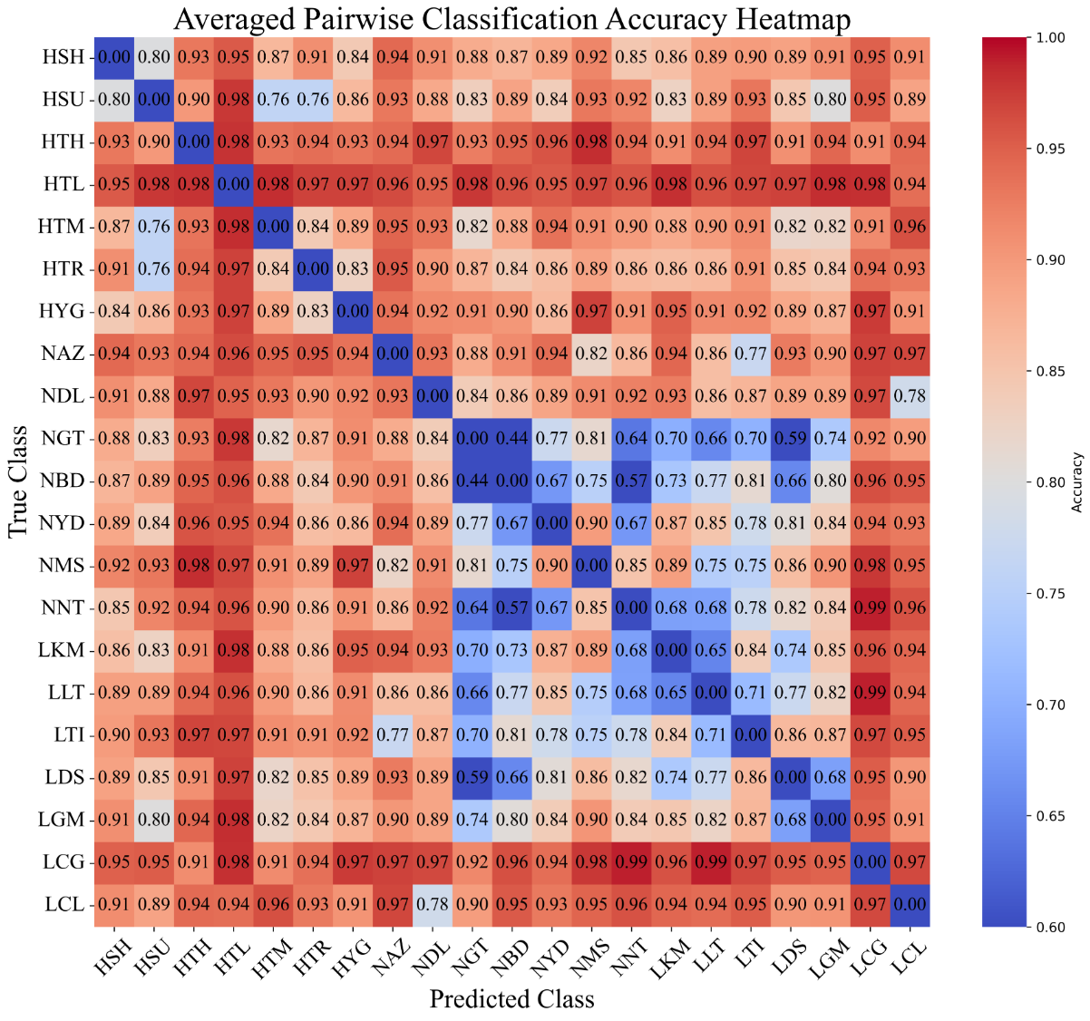
Classification (Pair-wise)
In HTs
✅HTL highest -> Oldest
❌HSU lowest -> Reference
In NMTs
✅ Amazon, DeepL
❌ Google
In LLMs
✅ ChatGPT, Claude
❌ DeepSeek

Slide 19
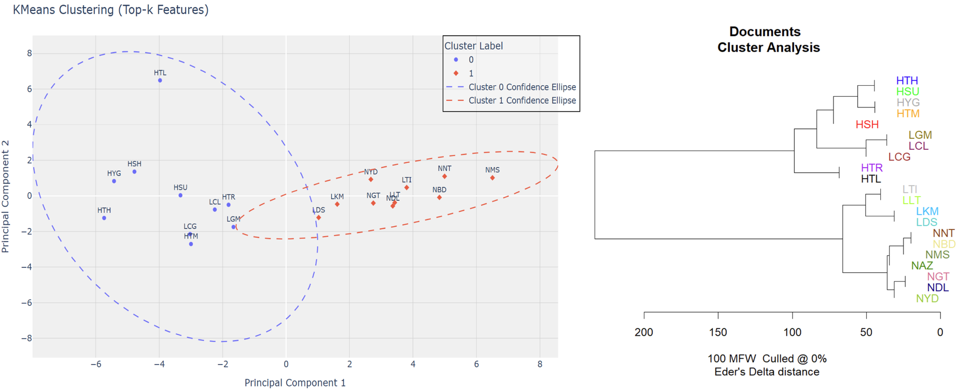
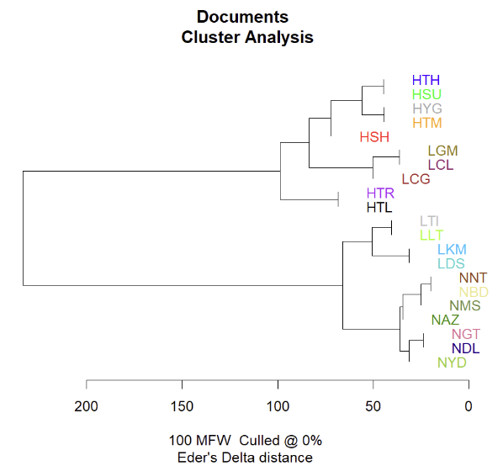


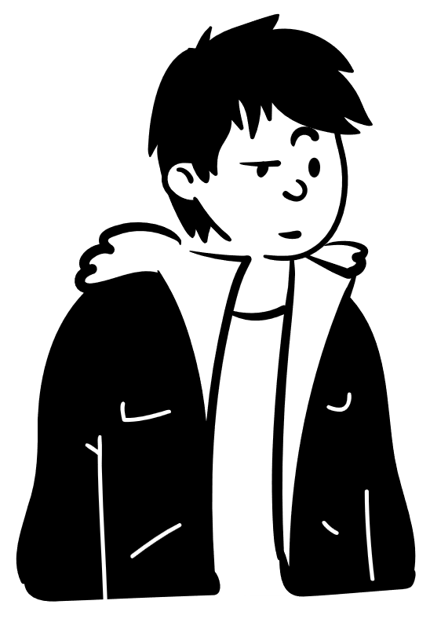



Clustering
0 is labeled as HTs
1 is labeled as MTs
ARI = 0.4873
Kmeans (2 Clusters)
HTs vs. NMTs: Better and clear
ChatGPT, Claude, Gemini -> HTs
4 -> NMTs
HTs are still the
Golden standard

Slide 20
Discussion

Slide 21


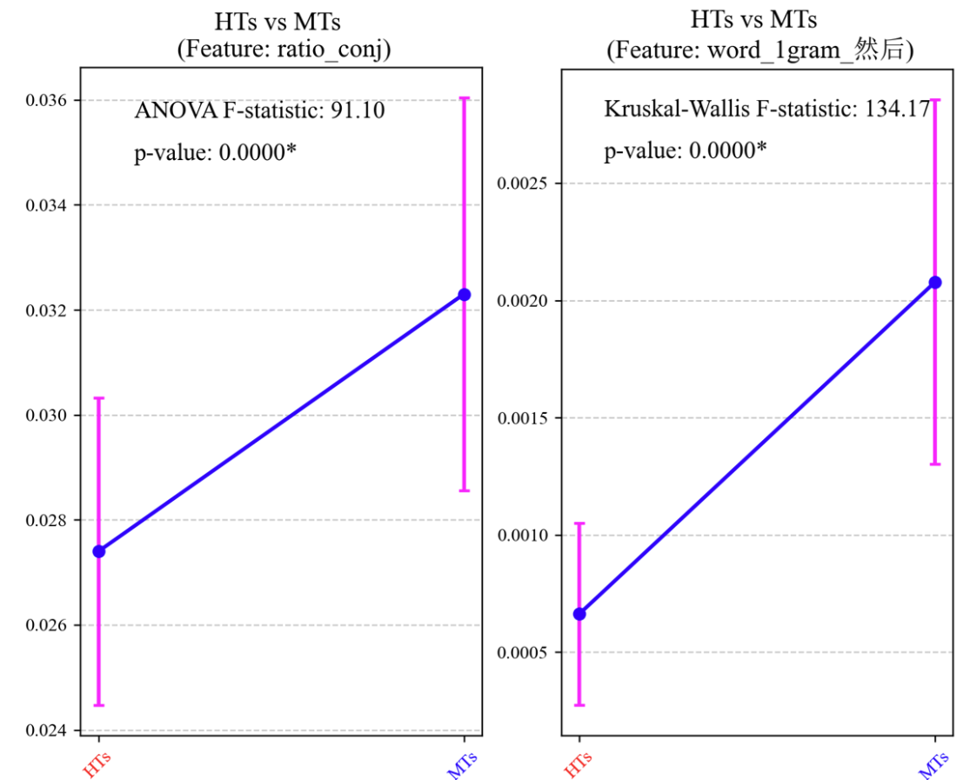
Ratio of conjunctions (H vs. M)
X label:
HTs MTs
HTs -> Less ratio of conjunctions
MTs -> more connections!
然后(Then) = n-gram feature = Conj.
HT < MT in 然后
“Explicitation” (Zhang et al., 2019)
Ori.Chs < HT < MT
Notes:
In this section, we illustrate some features that would separate each group apart.
Give some examples here to illustrate clear the question and feature.

Slide 22
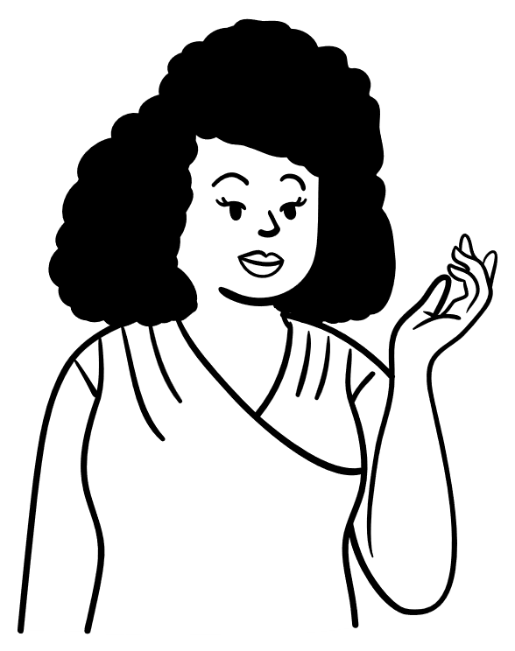

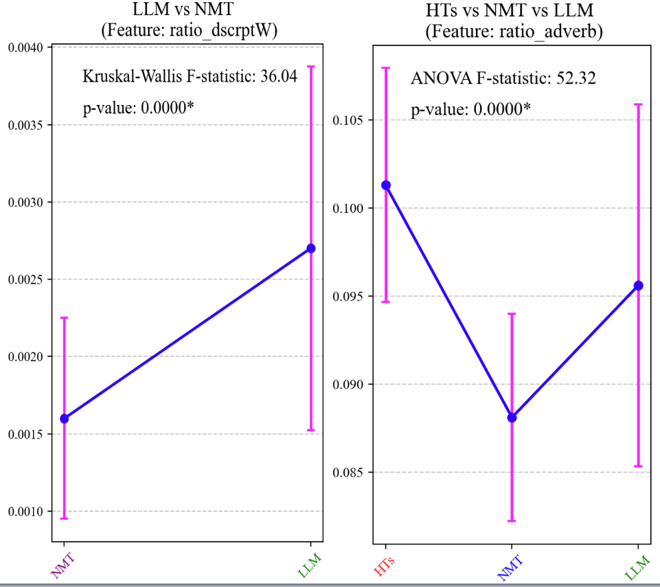

Descriptives and adverbs (H vs. N vs. L)
X label:
◀️NMT LLM
▶️HTs NMT LLM
Descriptive words and adverbs both are used to illustrate things or acts.
⏫vividness + expressiveness
HTs better than MTs
NMT < LLM
👑

Slide 23
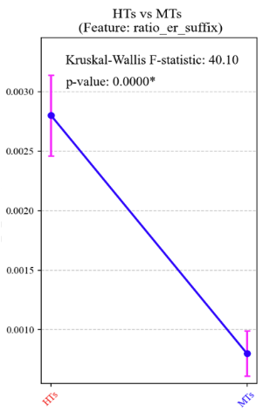
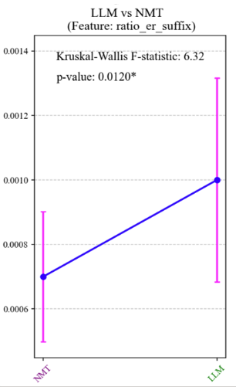
Ratio of –er suffix (H vs. M & N vs. L)
X label:
◀️ HTs MTs
▶️ NMT LLM
“-er suffix” conveys a colloquial, playful, or affectionate tone
“花” -> “花儿” ≈ “dog” -> “doggy” / “cat”
HTs lots of “-er” than MTs
NMT < LLM
👑
👑
<<<<<< HTs
Notes:
Particulary attractive to young children readers.

Slide 24
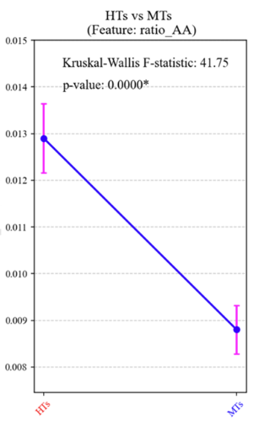
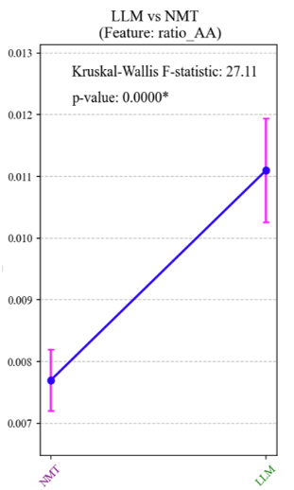
Ratio of AA repetition (H vs. M & N vs. L)
X label:
◀️ HTs MTs
▶️ NMT LLM
Repetitive patterns facilitate memory retention for young readers, fun to repeat, and soften the tone. (Childish!)
“热的” （hot) → “热热的” (warm and cozy)
NMT < LLM
👑
👑
<<<<<< HTs
Same!
Notes:
In this section, we illustrate some features that would separate each group apart.

Slide 25

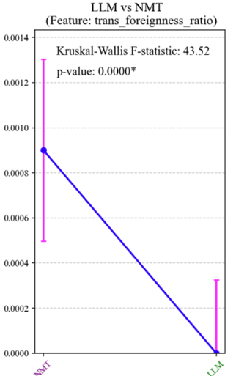
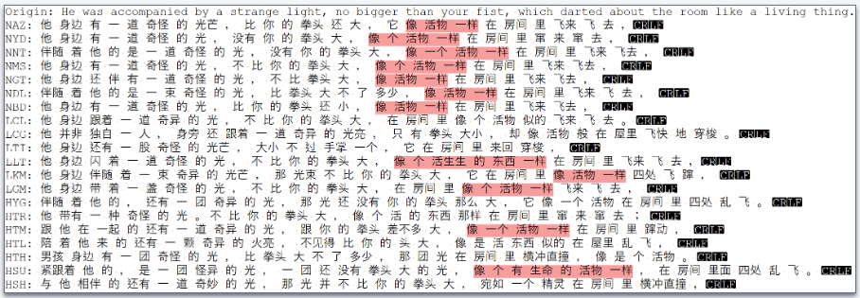
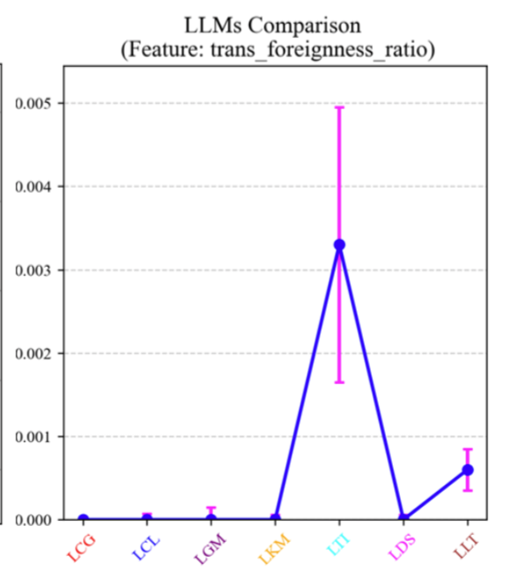
Dessert remarks
NMTs have more English retained in the output, HTs 0.
In LLMs, TowerInstruct and LaraTrans higher than others.
Stylistic variation: NMTs tendency of “homogenization” (Taivalkoski-Shilov 2018)
HT would use more varied expressions. LLM show similar tendency to HT. A good thing for CTT!
Notes:
OK! The main course has been served. We are presenting the dessert, so this part we would show you some of the interesting findings.
foreigness. Source text retained in the target text. Ratio of chinese words / english words in the translation.
Stylistic variation acoss transaltions.

Slide 26
Conclusion

Slide 27
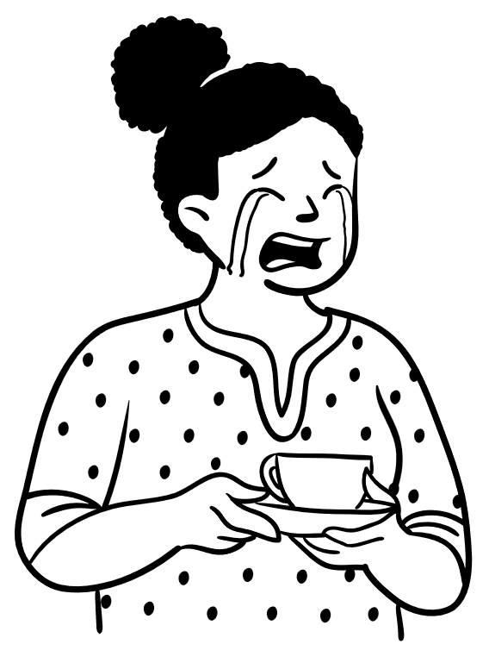
Conclusion
Limitation
We do not say NMT is bad in quality!
For a stylometric analysis based on CLT:
HTs vs. MTs → Great acc. ~ 90%
NMT vs. LLM → OK acc. ~ 75%
🥇HT ------- 🥈LLM --- 🥉NMT
Conjunction words, adverbs; -er suffix, repetitions, foreignness.
Why ChatGPT and Claude are so unique? Read the paper, s.v.p.
Data: Only Peter Pan. HTs trained in LLM.
Features: Unbalanced. Largely lexical. Overlapping.
Lack exploration into the reason of such stylistic deviations.
Prompt fine-tune may influence LLM output.

Slide 28



“Second star to the right and straight on 'til morning.”
Thank You
Delu Kong^{1,2}; Lieve Macken²
¹School of Foreign Studies, Tongji University
²LT3, Ghent University
Supplement: https://github.com/DanielKong1996/CLT_MTsummit
Contact: kongdelu2009@hotmail.com
We declare that no excessive CO₂ emitted and that no Captain Hook being injured during the study.

Slide 29
Reference
Read the paper, s.v.p.
And Questions?
Really? Not bored?

